Slide 1
Industrial MANIPULATOR End of arm tooling
PDE4431 Industrial Manipulators
Judhi Prasetyo & Bittu Scaria
Middlesex University Dubai

Slide 2
Abstract
An Industrial Manipulator has to be equipped with End of Arm Tooling to serve the purpose, the automation system or the manipulator is designed for. The lecture provides an introduction to the End of Arm Tooling, design guidelines, various types end of Arm Tooling and related accessories.

Slide 3
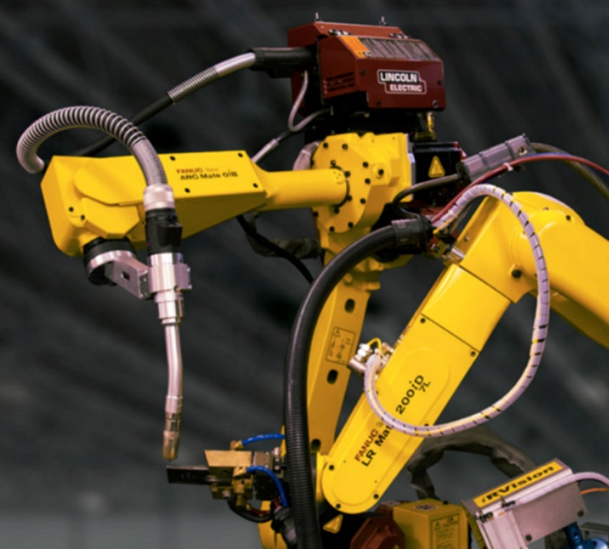
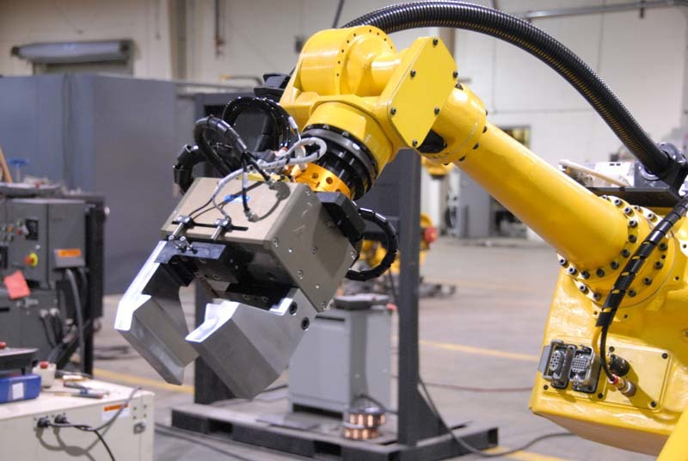
What is an End of Arm Tooling
End of arm tooling (EOAT) is a crucial aspect of robotic technology. It refers to the equipment that interacts with parts and components, typically at the end of a robotic arm. For example, the welding torch on a robotic welding system.

Slide 4
Functionality of End of Arm Tooling
The EOAT gives a robot a specific functionality and can be changed to fit different applications or even be built to accommodate several processes at once. Either way, advancements in EOAT capabilities are parallel to advancements in robotic capabilities.
https://www.youtube.com/watch?time_continue=95&v=i8Twl-NR0gw&feature=emb_logo

Slide 5
Common End of Arm Tooling used
There are many different types of EOAT for robots:
grippers
welding torches
force-torque sensors
vision sensors mounted to robot
material removal tools
collision sensors
tool changers and more.
They’re powered in different ways. The application dictates which type of EOAT is needed.

Slide 6
Key parameters End of Arm Tooling design
Application environment
Payload of the Industrial Manipulator selected for the application
Type of power source
Material to be handled or processed
Type of End of Arm Tooling(parallel / three finger / adaptive / and so on)
Mechanical mounting to the Manipulator

Slide 7
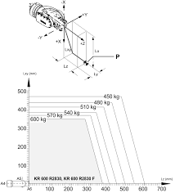

Slide 8
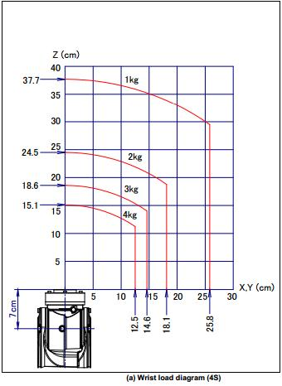
Payload
Robot payload is the weight a robot manipulator can lift. It includes the weight of the end of arm tooling (EOAT). Maximum payload varies from robot to robot.

Slide 9
OEMs providing Standard EOAT
Many equipment manufacturers concentrate in providing us with standard EOAT parts that can be added with customized parts in forming an EOAT Solution for the application.
Schunk-- https://schunk.com/de_en/homepage/
Destaco -- https://www.destaco.com/end-effectors
Robotiq -- https://robotiq.com/
Onrobot -- https://onrobot.com/en/products

Slide 10
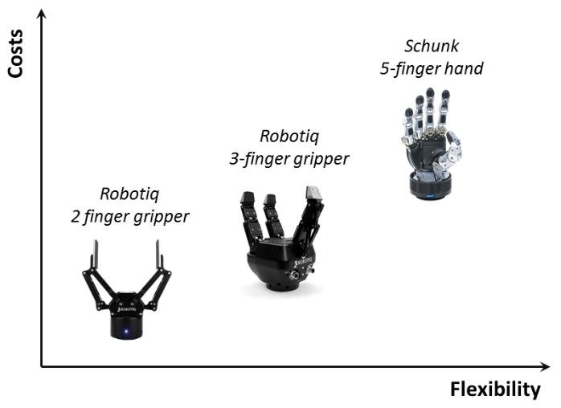
Cost v/s Flexibility

Slide 11
Robot System Integrator
Integration is the process of programming and outfitting industrial robots so they can perform automated manufacturing tasks. Robot integrators are companies that will analyze your robotic system needs, provide a plan for automation, and put the automation into production.
Perform a feasibility study on your project
Identify the correct robot, tooling, work cell for your application needs
Provide helpful cost-saving tips
Provide training on programming your robot system and work cell
Help incorporate the system into your factory setting

Slide 12
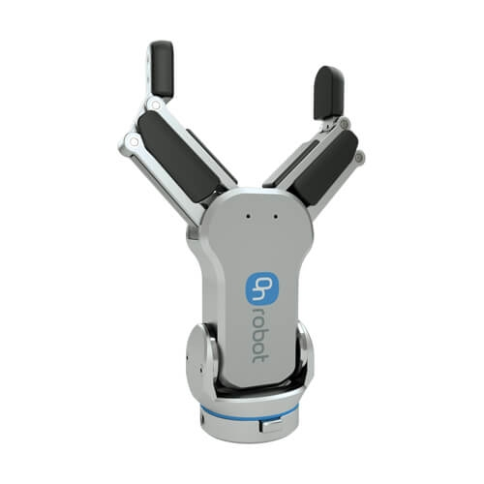
Let us look into few End of Arm Tooling
A Simple two finger gripping concept.
https://www.youtube.com/watch?time_continue=139&v=A_oQns-DsQo&feature=emb_logo

Slide 13
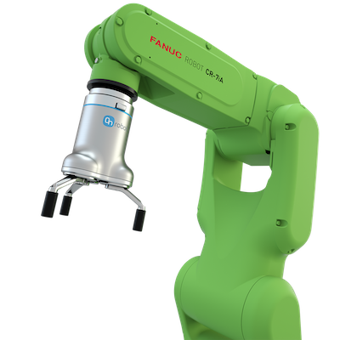
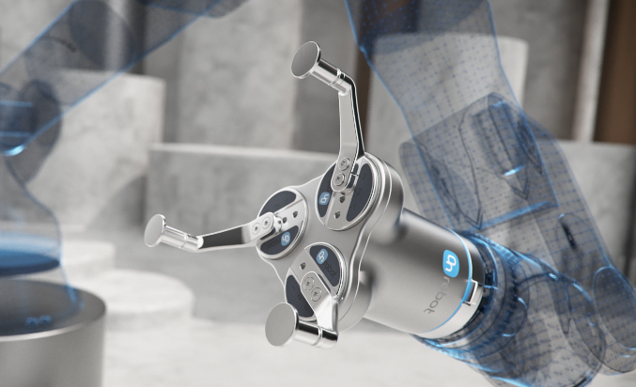
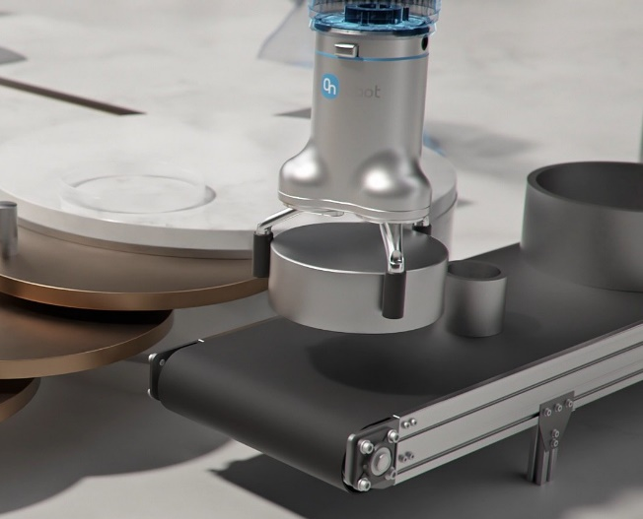
Three Finger Gripping Concept
https://www.youtube.com/watch?v=mddWF4EkVFQ

Slide 14
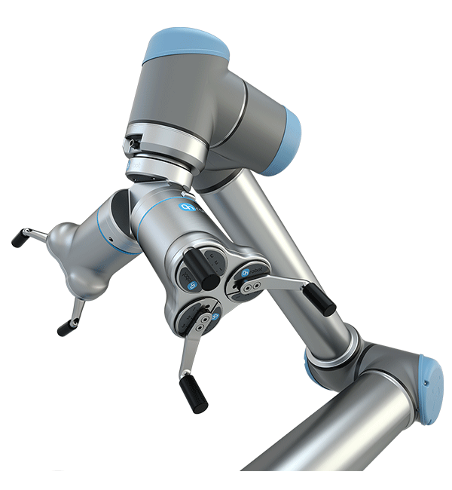
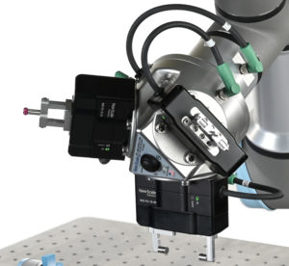
Twin Hand(Multi Hand) Gripping systems
When more than single gripper(two finger, three finger or any type) for holding multiple parts at time ,Multi Hand gripping systems are used.
https://www.youtube.com/watch?v=NcCxJceZGTU

Slide 15
Four Types of Gripper based on operation

Slide 16
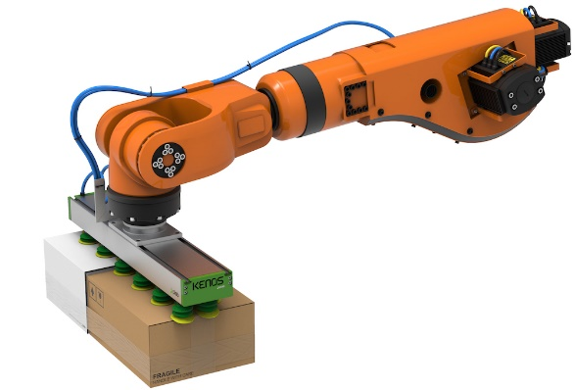
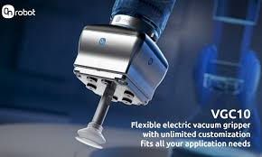
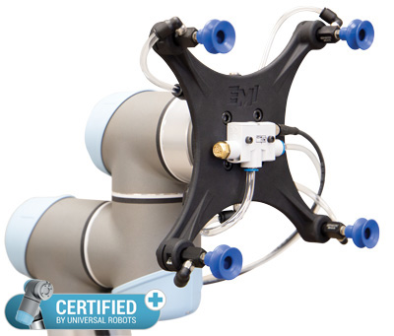
Vacuum Grippers
The vacuum gripper has been the standard EOAT in manufacturing because of its high level of flexibility. This type of robot gripper uses a rubber or polyurethane suction cup to pick up items. Some vacuum grippers use a closed-cell foam rubber layer, rather than suction cups, to complete the application.

Slide 17
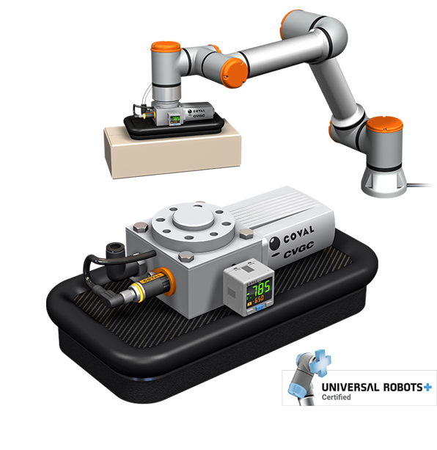
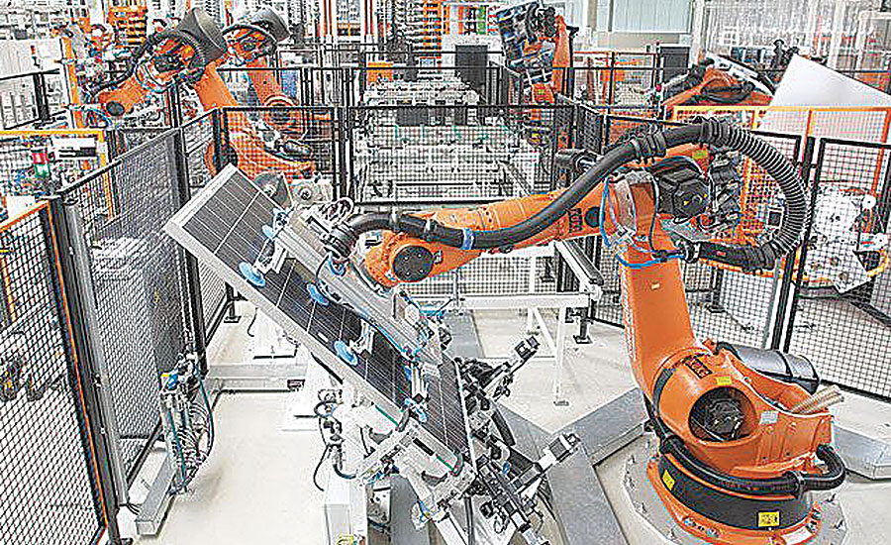

Slide 18
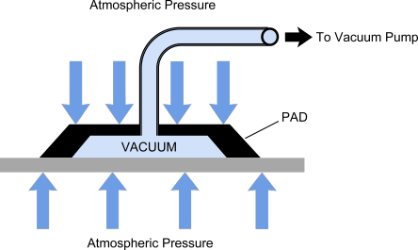
Vacuum gripping principle
https://www.youtube.com/watch?v=vX9-MzOTxmI
https://www.youtube.com/watch?v=G4Yxakt_SnU
https://www.youtube.com/watch?v=sHFLglkQmAs
https://www.youtube.com/watch?v=T6MDDY-J4RA

Slide 19
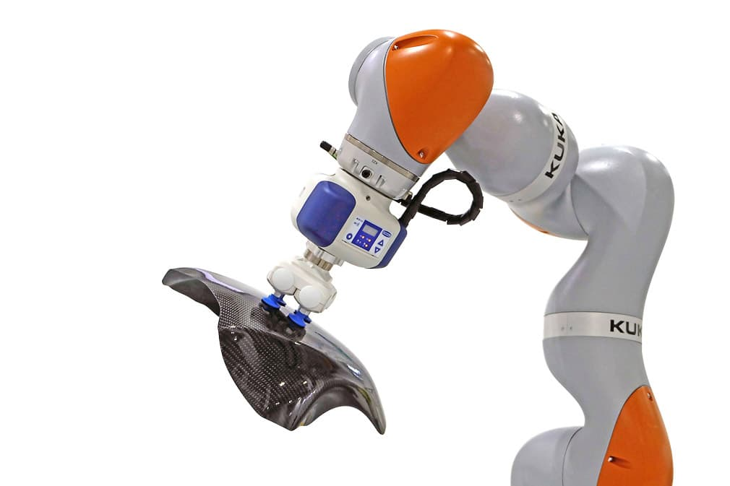
Integration of vacuum grippers
Vacuum input/pumps-input vacuum from a centralized vacuum line.
Pneumatic input/pump- input compressed air line from a centralized line or a compressor unit.
Electric Supply-input electric supply usually 24v DC to operate self incorporated vacuum system to generate vacuum.

Slide 20
To integrate a vacuum gripper the cups or pad have to be mechanically fitted to the end of the robot, which is fairly straight forward. Switching of the vacuum is required, which typically involves sending an analogue signal to a solenoid valve. A major part of the expense of integrating a vacuum gripper is the reticulation of the pneumatic hoses down the robot arm. Although many of the latest robots have in-built pneumatic and electrical reticulation.

Slide 21
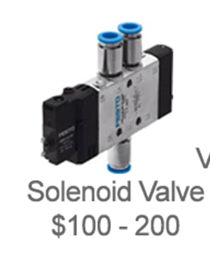
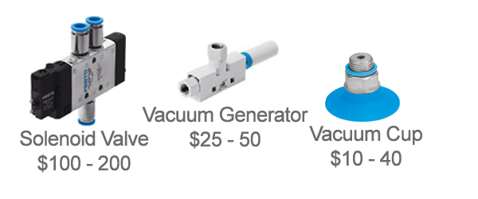
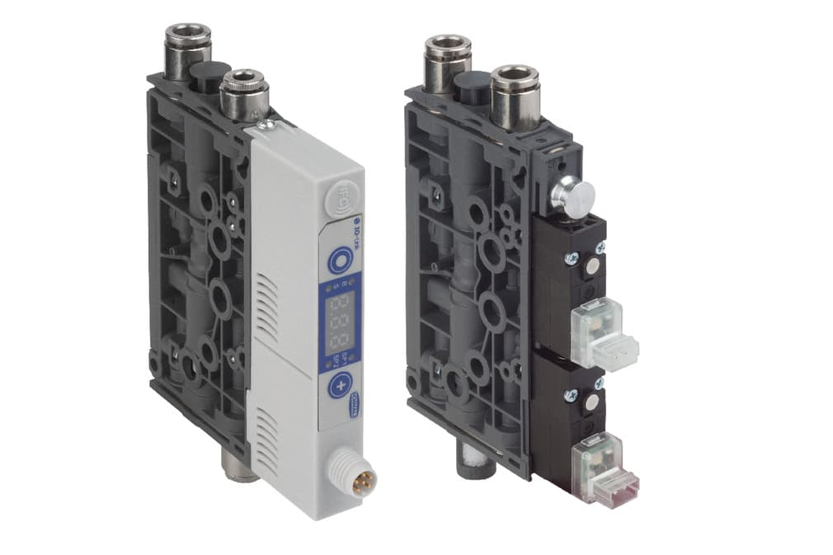
24v DC
Vacuum Line
24v DC
Compressed Air
24v DC
Compressed Air
Vacuum Generator with inbuild solenoid valve and pressure switch

Slide 22
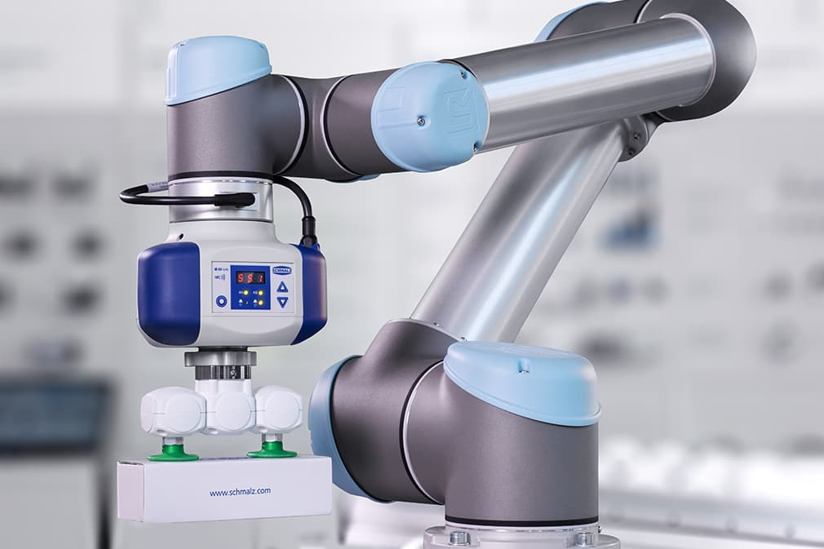
Electric vacuum generator
24v DC
https://www.schmalz-robotics.com/solutions/vacuum-generators/ecbpi/?lang=en

Slide 23


Slide 24
Pneumatic Grippers
The pneumatic gripper is popular due to its compact size and light weight. It can easily be incorporated into tight spaces, which can be helpful in the manufacturing industry. Pneumatic robot grippers can either be opened or closed, earning them the nickname “bang bang” actuators, because of the noise created when the metal-on-metal gripper operates.

Slide 25
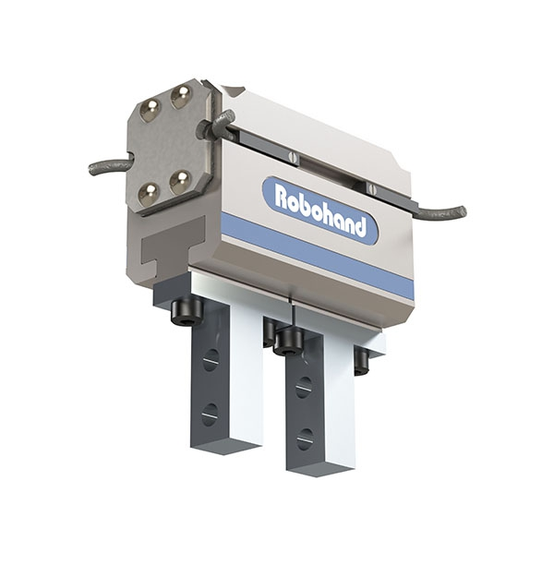
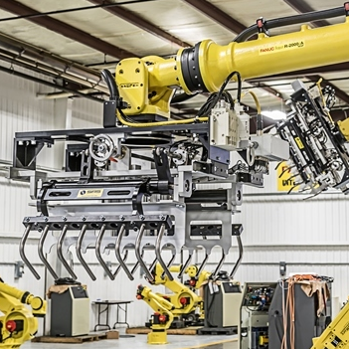
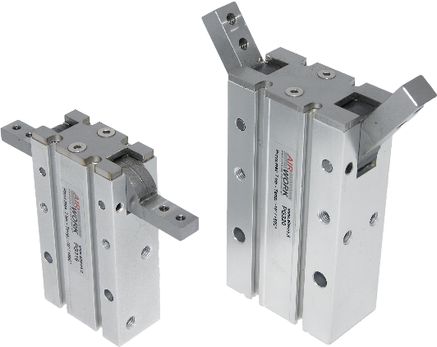
Types of Pneumatic grippers
The three major types of pneumatic grippers are
parallel gripper,
angular gripper design,
custom units

Slide 26
Pneumatic gripper integration
24v DC
Compressed air supply

Slide 27
Hydraulic Grippers
The hydraulic gripper provides the most strength and is often used for applications that require significant amounts of force. These robotic grippers generate their strength from pumps that can provide up to 2000psi. Although they are strong, hydraulic grippers are messier than other grippers due to the oil used in the pumps. They also may need more maintenance due the gripper being damaged because of the force used during the application.

Slide 28
Servo-Electric Grippers
The servo-electric gripper appears more and more in industrial settings, due to the fact that it is easy to control. Electronic motors control the movement of the gripper jaws. These grippers are highly flexible and allow for different material tolerances when handling parts. Servo-electric grippers are also cost effective because they are clean and have no air lines.
https://www.youtube.com/watch?v=EPsAuPqx8Ck

Slide 29
Discussion Topics
Adaptive Gripping
Gripping methods –internal and external gripping
Stroke of grippers
Advanced gripping concepts

